Slide 1
Project Presentation of FSE Project
On
Bloom - The Vibrant Blogging Platform
Sahil (2210992208)
Sahil (2210992211)
Sahil Saharan (2210992213)
Samiksha (2210992587)
Supervised By
Mr. Rahul
Department of Computer Science and Engineering,
Chitkara University, Punjab

Slide 2

Introduction
The MERN stack, comprising MongoDB, Express.js, React, and Node.js, offers a powerful and flexible framework for building modern blogging applications.
A blog is basically a website which is used for chronological listing of blog posts.
A blog has the most recent content shown first followed by the previously updated content.
2

Slide 3
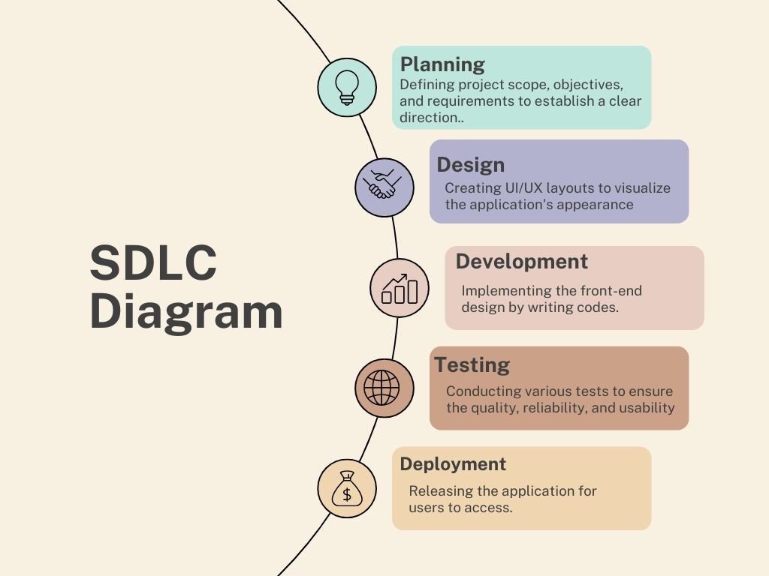
SDLC MODEL

Slide 4



TECHNICAL DETAILS
HTML:
Markup language for creating the structure of web pages.
Utilizes elements like <div>, <p>, <img> to organize content.
Forms for user input, with various input types like text, password, etc.
Semantics for accessibility and SEO.
TAILWIND CSS:
A utility-first CSS framework for styling HTML elements.
Simplifies layout design with classes for the box model: content, padding, border, and margin
Provides utility classes for positioning, display, flexbox, and grid layouts.
Enables responsive design through media query utilities.
REACTJS:
Allows dynamic rendering of HTML content based on real-time data.
Facilitates reusable components like headers, footers, and forms.
Supports conditional rendering to tailor content based on user roles or data.
Seamlessly integrates form handling for actions like login and data submissions.
Efficiently loops through arrays to render dynamic content such as notices, events, or appointments.

Slide 5

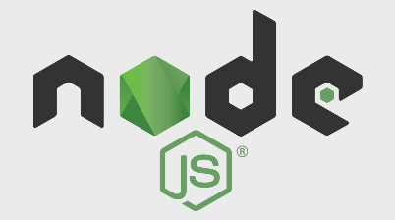
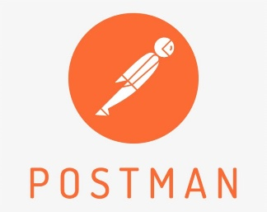
TECHNICAL DETAILS
Backend
MongoDB:
NoSQL database designed for handling large volumes of data.
Uses flexible, JSON-like documents to store data.
Supports dynamic schemas, allowing easy updates to data structure.
Provides horizontal scaling for managing distributed data.
Facilitates fast queries and indexing for efficient data retrieval.
Express:
Express is a minimal and flexible Node.js web application framework
that provides a robust set of features for web and mobile applications.
Express is a lightweight and flexible routing framework with minimal
core features meant to be augmented through the use of Express middleware modules.
Postman:
Postman is a global software company that offers an API platform for developers to design, build, test, and collaborate on APIs.

Slide 6
Features
Overview: A modern blogging website designed for users to easily create, edit, and share content.
Key Features:
Easy-to-use interface
Responsive design for all devices
Customizable themes and layouts
Saved by relevant category
Post Management: Create, edit, and delete blog posts effortlessly.
Tagging and Categorization: Organize posts using tags and categories.
Comments Section: Engage with readers through a built-in comments feature.
SEO Optimization: Inbuilt SEO tools to help users rank their blogs higher on search engines.

Slide 7

Target Audience
Who is this for?
Bloggers
Writers
Content creators
Businesses looking to share updates and articles
Goal: Empower users to share their ideas and stories effortlessly.

Slide 8
User-Friendly Interface
Drag-and-Drop Functionality: Users can easily create and structure their blog posts.
Rich Text Editor: Built-in tools for formatting text, adding images, videos, and links.
Intuitive Navigation: Simple menus for easy access to different sections of the website.

Slide 9
Languages
MongoDB
A NoSQL database that stores data in flexible, JSON-like documents, perfect for content-rich applications like blogs.
Express.js
A minimal and flexible Node.js web application framework that provides a robust set of features for web and mobile applications.
React
A powerful JavaScript library for building user interfaces, enabling the creation of dynamic, responsive, and interactive blog experiences.
Node.js
A JavaScript runtime built on Chrome's V8 JavaScript engine, allowing server-side scripting and efficient data handling.

Slide 10
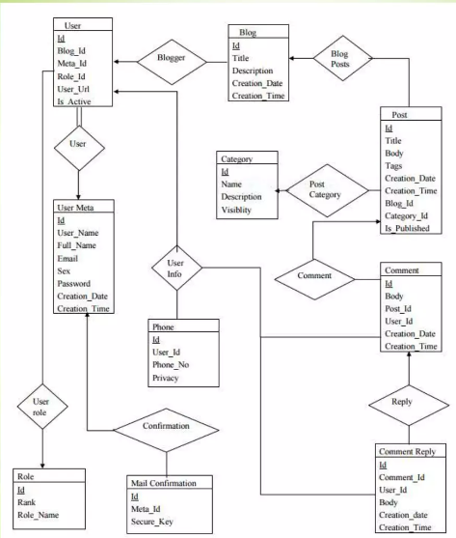
ER Diagram

Slide 11
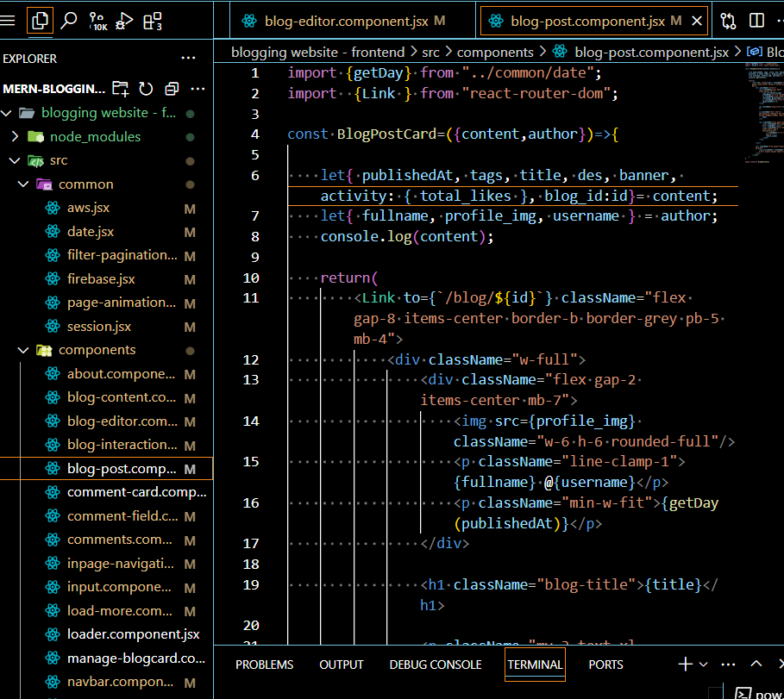
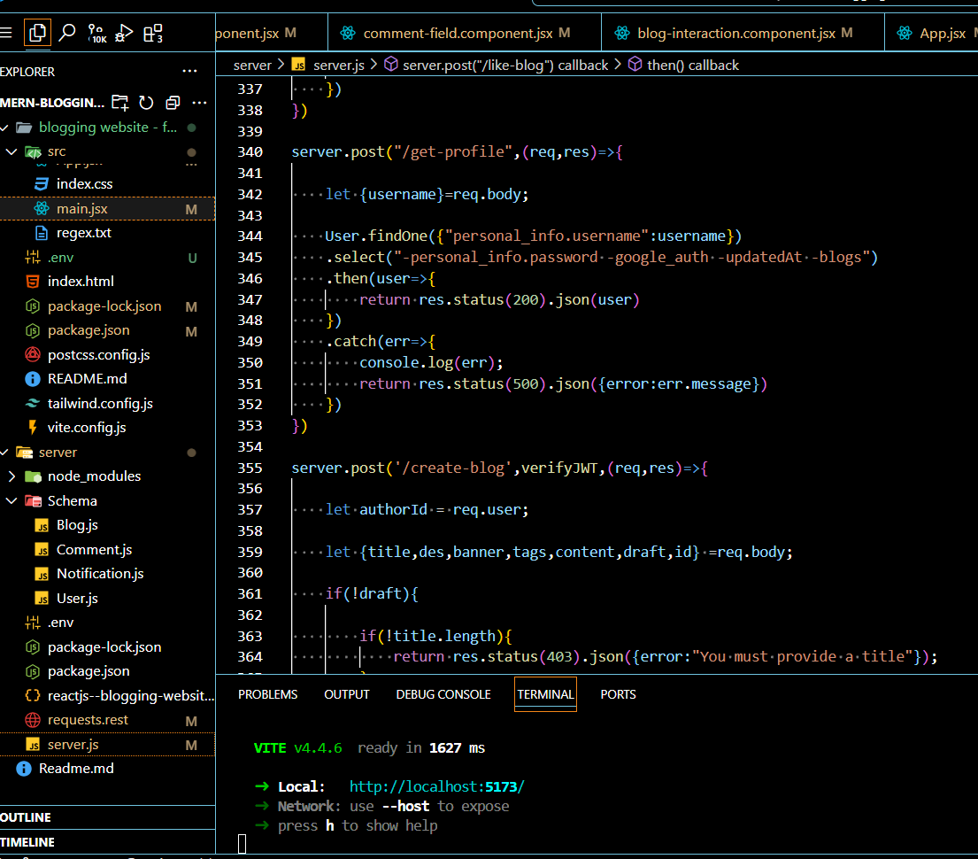
Code Snippets

Slide 12
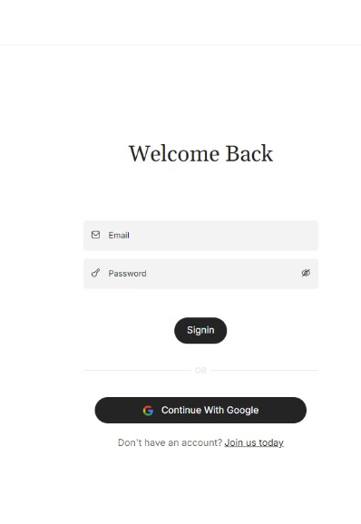
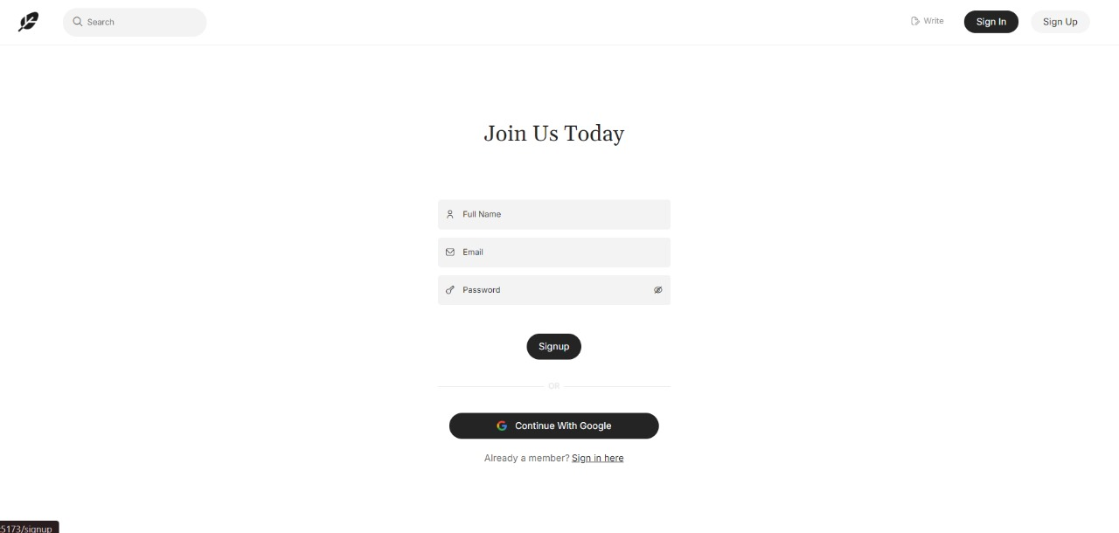
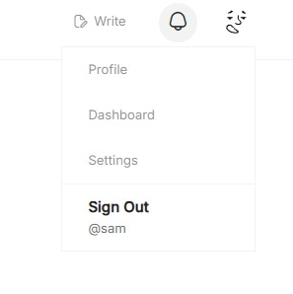
Output
Sign up
👇
Sign in
👇
Sign out
👇

Slide 13
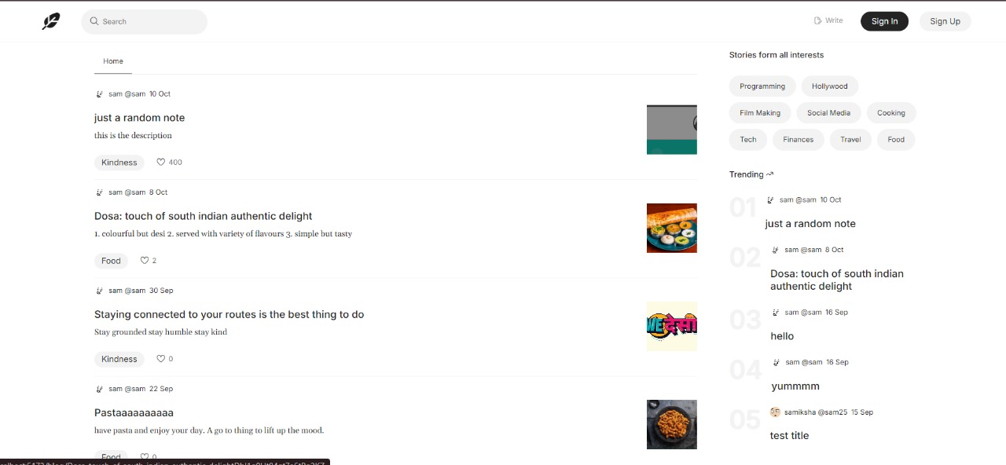
Output
Home Page

Slide 14
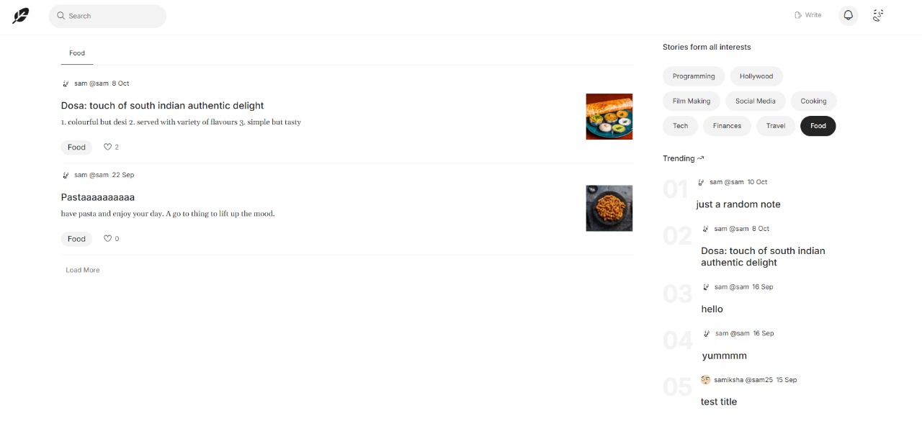
Output
Sorted By Interests

Slide 15
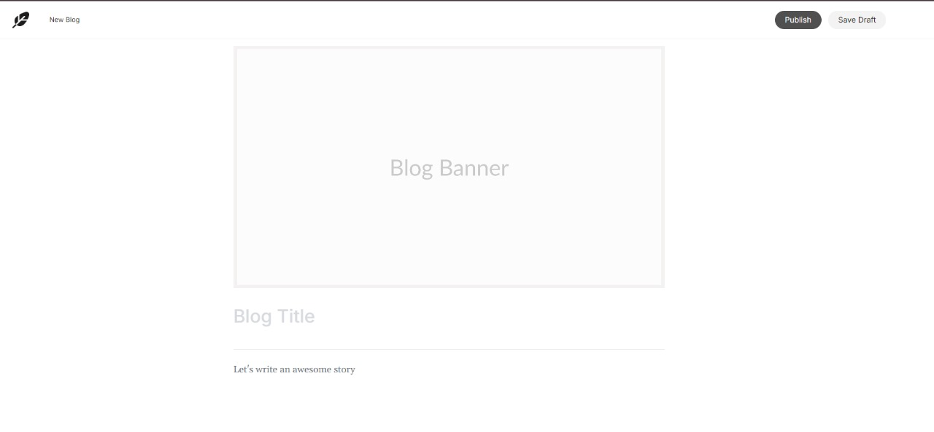
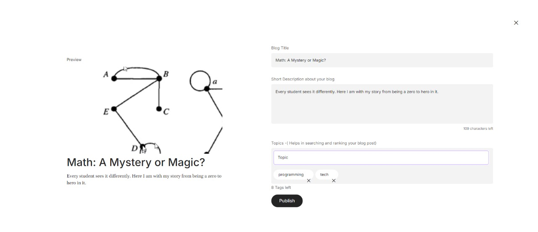
Output
👈👈Editor
Preview👉👉

Slide 16
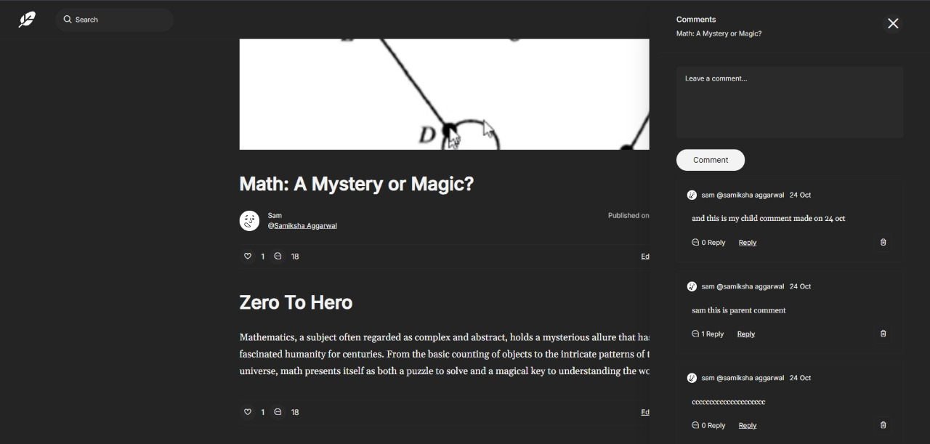
Project Snippet

Slide 17
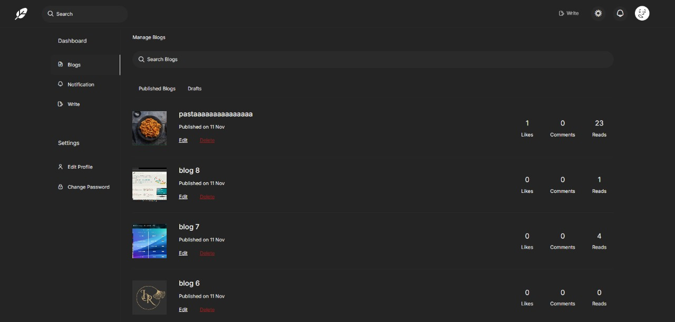
Project Snippet

Slide 18

CONCLUSION
Bloom - The Vibrant Blogging Platform offers a seamless and dynamic solution for content creators. With a user-friendly back-end system, it empowers users to effortlessly create, edit, and share blogs. By prioritizing performance, scalability, and security, Bloom ensures a smooth experience for both bloggers and readers. The project showcases efficient data management, real-time updates, and a robust architecture that supports future growth.
Key Highlights:
Efficient Content Management: Easy-to-use tools for bloggers.
Scalable Architecture: Designed to handle increasing traffic and content volume.
Security Features: Protecting user data and ensuring platform integrity.
Future-Ready: Built with potential for further enhancements and features.
In conclusion, Bloom is not just a blogging platform—it's an intuitive, vibrant space for creativity to flourish.

Slide 19


